Slide 1
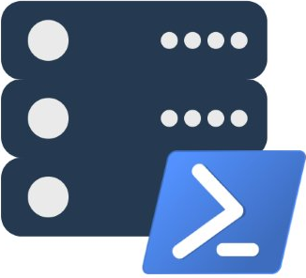
dbatools
Presented by @cl and @mobileck
dbatools.io | dbatools.io/slack | dbatools.io/youtube

Slide 2
About
Chrissy LeMaire - @cl
A tee from Kaplan
PowerShell MVP
Creator of dbatools.io
PASS PowerShell VG, Belgian PowerShell UG
DBA with General Dynamics IT at NATO Spec Ops HQ
Rob Sewell - @sqldbawithbeard
PowerShell MVP
Creator of SQLDiagAPI
PASS PowerShell VG, SQL Saturday Exeter
PowerShell Consultant and Trainer
dbatools.io | dbatools.io/slack | dbatools.io/youtube

Slide 3

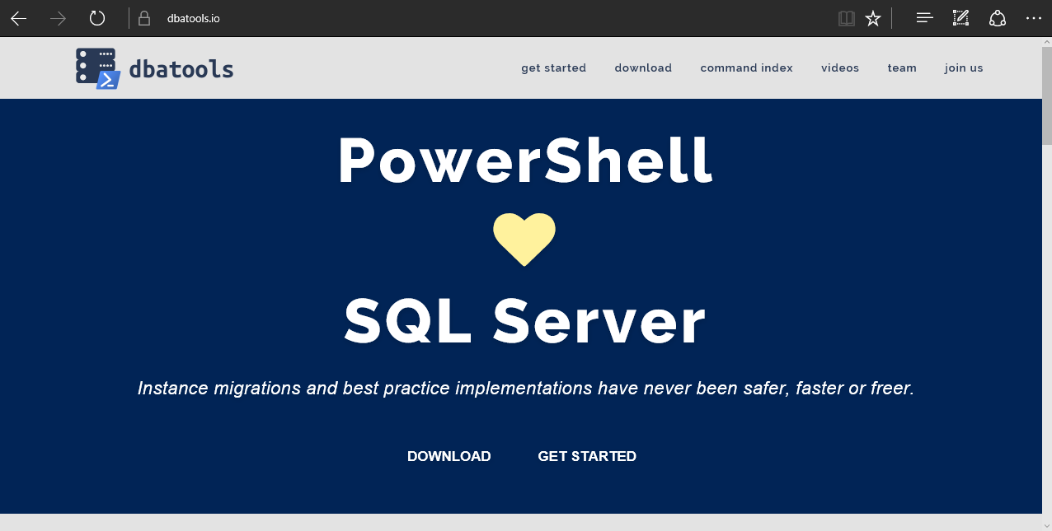
dbatools
dbatools.io | dbatools.io/slack | dbatools.io/youtube
Notes:
Community project, initially started out as Start-SqlMigration but has grown into a DBA’s best friend. dbatools currently sports nearly 300 commands.
How many of you have heard of dbatools? How many of you have used it?

Slide 4
Support
SQL Server 2000 – vNext
Express – Enterprise Edition
Clustered and stand-alone instances
Windows and SQL authentication
Default and named instances
Multiple instances on one server
dbatools.io | dbatools.io/slack | dbatools.io/youtube
Notes:
Started as a migration tool, so I strived to support older environments
No reliance on SQLPS, because we’ve got a history ;)

Slide 5
System Requirements
Minimum
Client
PowerShell v3
Server
SQL Server 2000
No PowerShell for pure SQL commands
PowerShell v2 for Windows commands
PowerShell remoting enabled for Windows commands
Recommended
Client
PowerShell v5.1
Server
SQL Server 2008R2+
dbatools.io | dbatools.io/slack | dbatools.io/youtube
Notes:
Started as a migration tool, so I strived to support older environments
No reliance on SQLPS, because we’ve got a history ;)

Slide 6
Install is easy
PowerShell Gallery
Install-Module dbatools
Install-Module dbatools –Scope CurrentUser
GitHub – dbatools.io/git
Invoke-Expression (Invoke-WebRequest https://dbatools.io/in)
Offline installer
dbatools.io/offline
dbatools.io | dbatools.io/slack | dbatools.io/youtube
Notes:
Gallery requires admin access and is built into PowerShell v5. Other versions also support it with a bit of configuration.
Download
Unzip
Import-Module

Slide 7
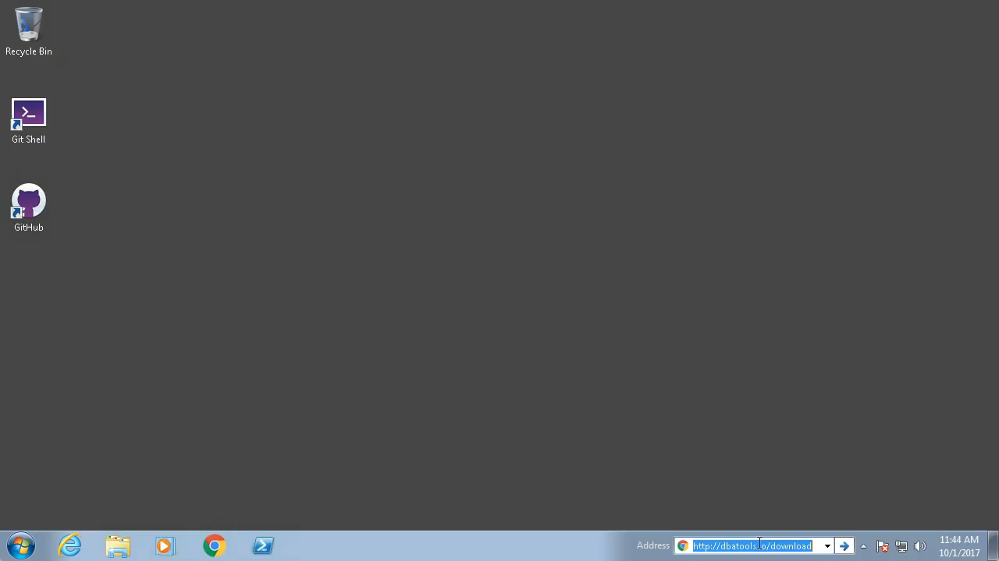
Supa easy
dbatools.io | dbatools.io/slack | dbatools.io/youtube
Notes:
Gallery requires admin access and is built into PowerShell v5. Other versions also support it with a bit of configuration.
Download
Unzip
Import-Module

Slide 8
Summit Precon
PowerShell Syntax ≈ T-SQL
Benefits of PowerShell and when to use vs. T-SQL
Remoting & security
Pester ❤️ SQL Server
Lab with migration and Pester tests
PowerShell & SQL Server Agent
dbatools development in practice
dbatools.io | dbatools.io/slack | dbatools.io/youtube

Slide 9
demo
dbatools.io | dbatools.io/slack | dbatools.io/youtube

Slide 10

Community got us feelin’ like
dbatools.io | dbatools.io/slack | dbatools.io/youtube
Notes:
Cut it out.

Slide 11
How to Get-Help
Extensive documentation within each command Get-Help Start-DbaMigration –Detailed
Extensive documentation on dbatools.io
dbatools.io/Start-DbaMigration
dbatools.io/Repair-DbaOrphanUser
Some commands have videos
dbatools.io/youtube
dbatools.io | dbatools.io/slack | dbatools.io/youtube

